Slide 1
What ExxonMobil did, and why it matters
Naomi Oreskes and Geoffrey Supran
History of Science, Harvard University
Notes:
Naomi Oreskes
Geologist, Earth Historian (These are her slides from the presentation given at the Midwest Renewable Energy Fair, Saturday, June 22 2019 at 1:00 p.m.)
(This is her bio from the Energy Fair’s website.)
Naomi Oreskes, Ph.D. is the author of The Scientific Consensus on Climate Change, which laid to rest the idea that there was significant disagreement in the scientific community about the reality of global warming and its human causes.
Since its publication, the essay has been widely cited by scientific and political leaders – including Sir David King, science advisor to Tony Blair – in The New Yorker, USA Today, National Geographic, and Parade, in the Royal Society’s publication, A Guide to Facts and Fictions About Climate Change, and, most notably, in Al Gore’s film, An Inconvenient Truth. In an interview on NPR, the former Vice President told Terry Gross that, when he goes on the road, the single item that provokes the most discussion is his analysis of this study.
Professor Oreskes teaches the History of Science and Affiliated Professor of Earth and Planetary Sciences at Harvard University. She recently arrived at Harvard after spending 15 years as Professor of History and Science Studies at the University of California, San Diego, and Adjunct Professor of Geosciences at the Scripps Institution of Oceanography. Professor Oreskes’s research focuses on the earth and environmental sciences, with a particular interest in understanding scientific consensus and dissent. She has held grants from the National Science Foundation, the National Endowment for the Humanities, and the American Philosophical Society, and is listed in Who’s Who in America and Who’s Who in Science and Engineering. Her op-ed pieces have appeared in The Washington Post, The Los Angeles Times, The Times (London), Nature, Science, The New Statesman, Frankfurter Allgemeine, and elsewhere.
Professor Oreskes’s books include The Rejection of Continental Drift: Theory and Method in American Earth Science, Science Without Laws: Model Systems, Cases, Exemplary Narratives, and Plate Tectonics: An Insider’s History of the Modern Theory of the Earth, which was cited by Library Journal as one of the best science and technology books of 2002, and by Choice as an outstanding academic title of 2003. Her latest book is Merchants of Doubt: How a Handful of Scientists Obscured the Truth on Issues from Tobacco Smoke to Global Warming, co-written with Erik M. Conway, was shortlisted for the Los Angeles Time Book Prize and received the 2011 Watson-David Prize from the History of Science Society.
Professor Oreskes was recently featured in the New York Times, which called her “a lightning rod in a changing climate.” Climate researchers Benjamin D. Santer and John Abraham say, “her courage and persistence in communicating climate science to the wider public have made her a living legend among her colleagues.” Her writing on climate change can also be found in the introduction of Pope Francis’s new book Encyclical on Climate Change and Inequality, out in August 2015.

Slide 2
We all know the concept of a Good News/ Bad News story Climate Change is a Bad News/ Good News/Bad News Story

Slide 3
Climate change is real, it’s underway, and it’s already hurting us. Here and now.

Slide 4
Clean Energy Revolution is underway.
Wind and solar are better and cheaper, and they are available here and now,.

Slide 5
The Fossil Fuel Industry stands in our way.
For thirty years, the industry has promoted confusion about climate change, and blocked our path to a clean energy future.

Slide 6
I’m a historian. But I am not just interested in past.
I’m interested in the present and future, too.
Continued obstruction by fossil fuel industry motivated me to understand and expose how the fossil fuel industry has misled the American people about climate change.

Slide 7
Because until we fully recognize and come to grips with the role they have played, they will continue to obstruct progress.
We won’t get the clean energy future we need and deserve.

Slide 8
Have communications about climate change
by ExxonMobil and other fossil fuel companies
misled customers, shareholders, or the public?

Slide 9
A timeline of climate denial.
Fact: The fossil fuel industry has known about the threat of climate change for a long time
Adapted from original graphic.
Paul Horn/ICN not responsible for any changes.
PAUL HORN /InsideClimate News

Slide 10
1954: American Petroleum Institute alerted its members that burning fossil fuels increasing atmospheric CO₂
Based on a very technical observation: changing ratios of carbon isotope in atmosphere
Franta B Nature Clim. Chg. 8, 1024 (2019)
Adapted from original graphic.
Paul Horn/ICN not responsible for any changes.
PAUL HORN /InsideClimate News

Slide 11
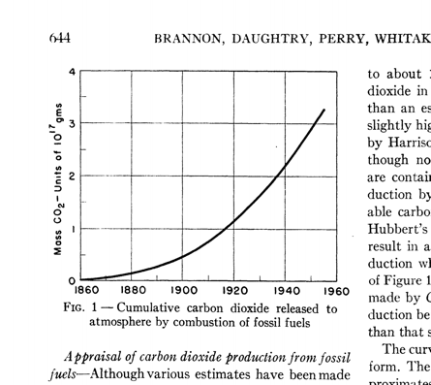
1957: Humble Oil quantifies
“cumulative mass of fossil carbon dioxide”
Brannon H R et al. Trans Am. Geophys. Union 643 (1957)
Adapted from original graphic.
Paul Horn/ICN not responsible for any changes.
PAUL HORN /InsideClimate News

Slide 12
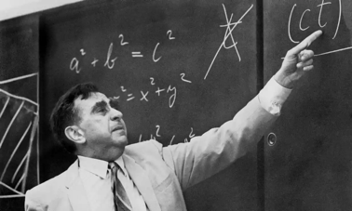
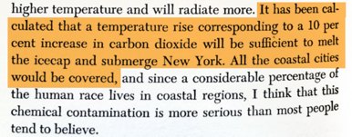
1959: API warned by Edward Teller
about “greenhouse effect”,
global warming, sea level rise
Franta B. The Guardian (1 Jan 2018)
Adapted from original graphic.
Paul Horn/ICN not responsible for any changes.
PAUL HORN /InsideClimate News

Slide 13
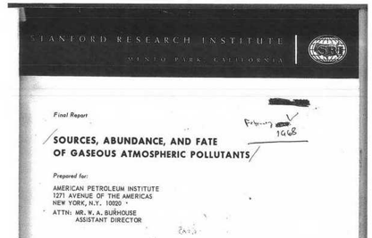
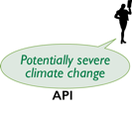
1968/69/72: API-commissioned reports
warn of potentially “severe” climate change
Robinson E, Robbins R C (1968) Sources, abundance, and fate of gaseous atmospheric pollutants. Final report.
Robinson E, Robbins R C (1969) Sources, abundance, and fate of gaseous atmospheric pollutants. Supplement.
Robinson E (1972) Advances in Chemistry 113, 1
Adapted from original graphic.
Paul Horn/ICN not responsible for any changes.
PAUL HORN /InsideClimate News

Slide 14
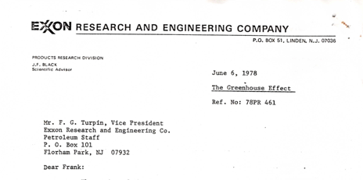
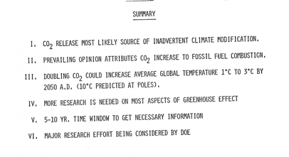
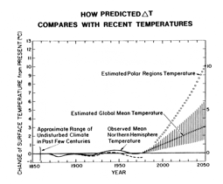
1977: Exxon scientist briefs executives on
global warming projections & climatic effects
Black J. The Greenhouse Effect (1978)
Adapted from original graphic.
Paul Horn/ICN not responsible for any changes.
PAUL HORN /InsideClimate News

Slide 15
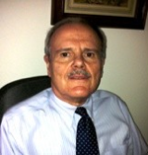
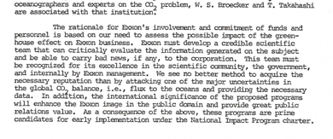
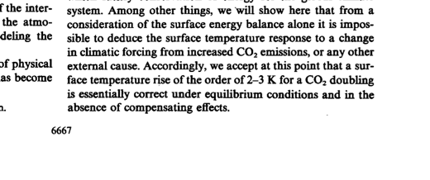
1978-9: Request for a “credible scientific team”
for climate research at Exxon
Shaw H. Untitled (request for a credible scientific team) (1978)
Hoffert M I, Callegari A J, Hsieh C-T. J. Geophys. Res. 85 6667 (1980)
Hoffert M I, Wey Y-C, Callegari A J, Broecker W S. Clim. Change 2, 53 (1979)
Adapted from original graphic.
Paul Horn/ICN not responsible for any changes.
PAUL HORN /InsideClimate News

Slide 16
In hindsight, one former Exxon Scientist put it this way:
“By the late 1970s, global warming was no longer speculative.
…
The issue was not were we going to have a problem,
the issue was simply how soon and how fast and how bad
was it going to be. Not if.”
DR. EDWARD GARVEY
Exxon climate researcher, 1978-83
Interviewed 2015 & 2018
Osborne J (2 Oct 2015) Dallas News
Westervelt A (14 Nov 2018) Drilled: A True Crime Podcast about Climate Change, Ep 1

Slide 17
?
?
Adapted from original graphic.
Paul Horn/ICN not responsible for any changes.
PAUL HORN /InsideClimate News

Slide 18
Exxon faced a critical decision
To accept the conclusions of scientists, including their own employees, and begin to change their business model.
Or to go down the path of denial, and continue to sell oil and gas as if that were not the existential threat that they knew it was.
Spoiler alert…

Slide 19
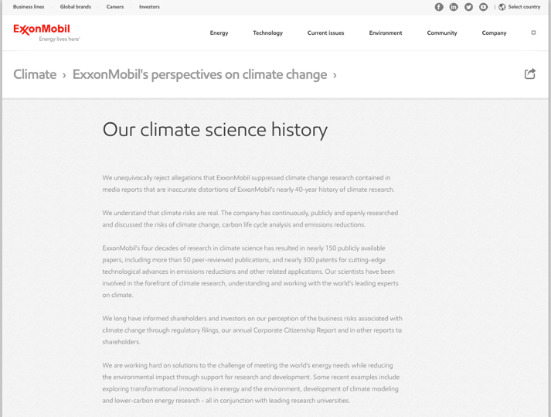
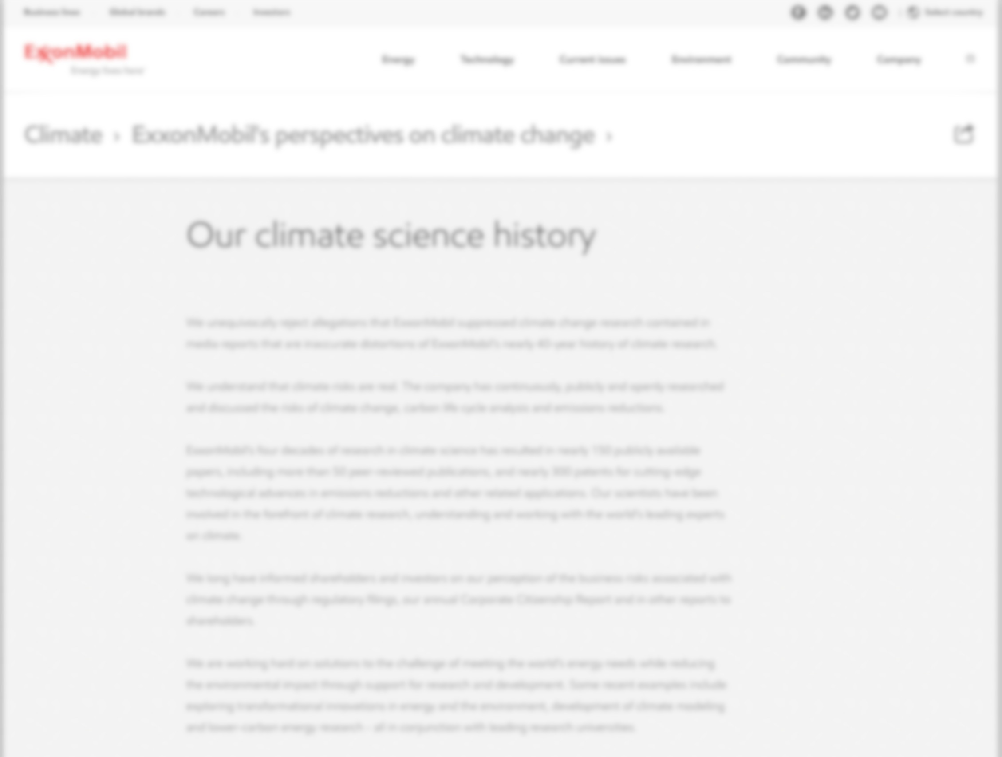
ExxonMobil 2017

Slide 20
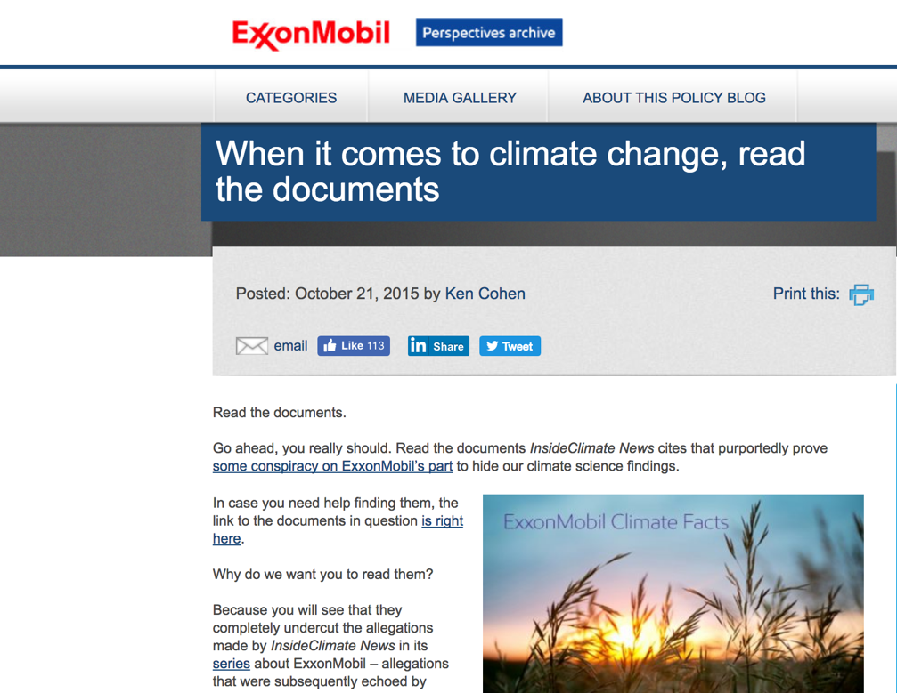

Slide 21
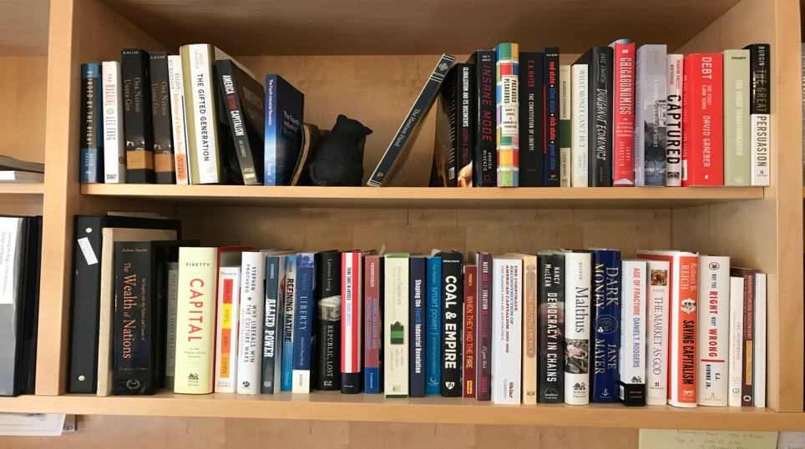
I’m a historian. Reading books and documents is what I do for a living.

Slide 22
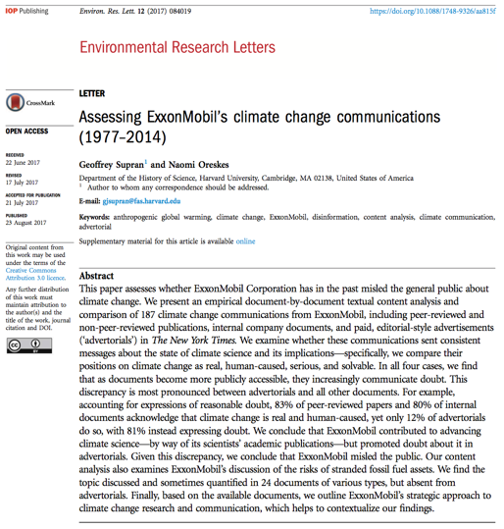
Online at bit.ly/ExxonPaper

Slide 23
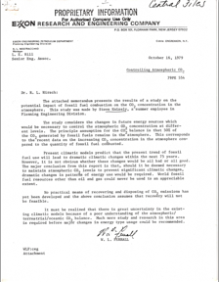
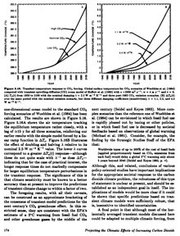
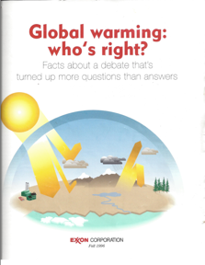
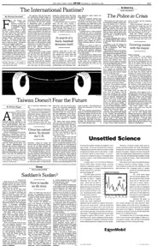
Internal Documents
37 (1977-1995)
Peer-Reviewed
72 (1982-2014)
Non-Peer-Reviewed
47 (1980-2014)
Advertorials
36 (1989-2004)

Slide 24
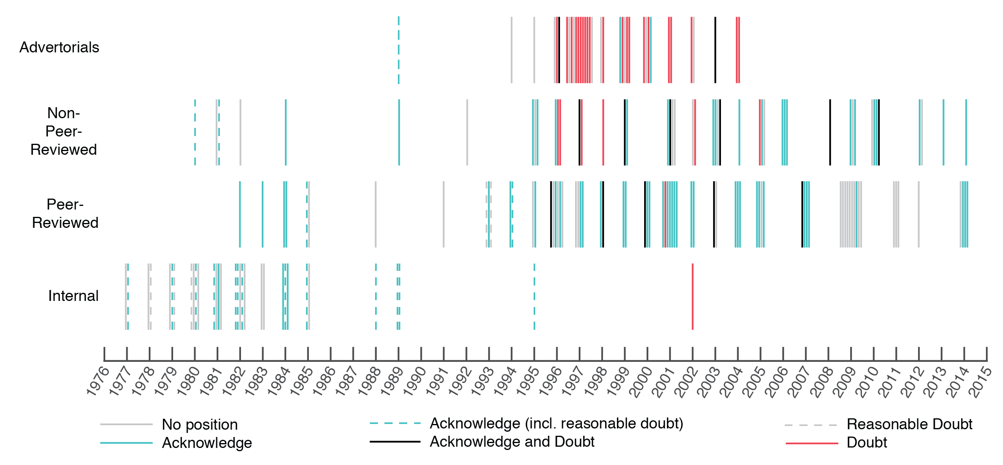

Slide 25
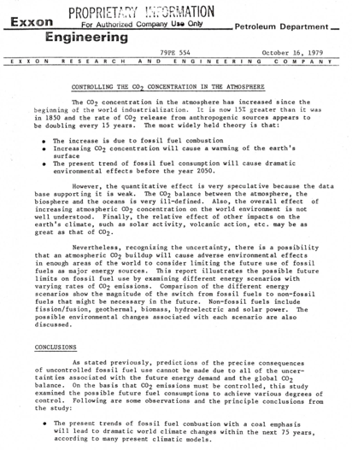
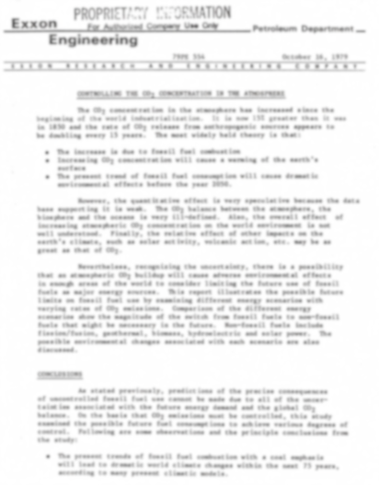
Mastracchio R L 1979 Controlling Atmospheric CO₂

Slide 26
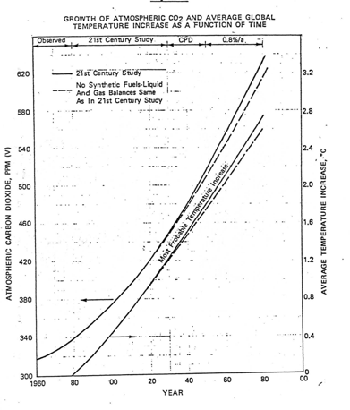
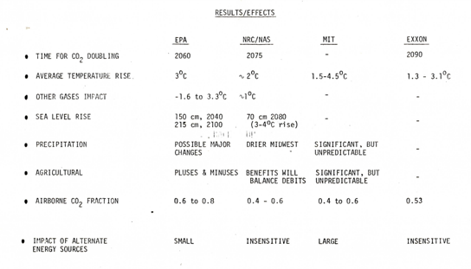
“Estimate of the average global temperature increase”
under the “Exxon 21st Century Study-High Growth scenario”
Glaser M B 1982 CO2 ‘Greenhouse’ Effect
Shaw H 1984 CO2 Greenhouse and Climate Issues EUSA/ER&E Environ. Conf., New Jersey

Slide 28
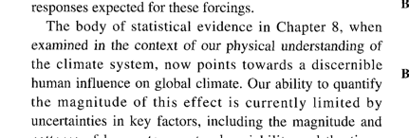
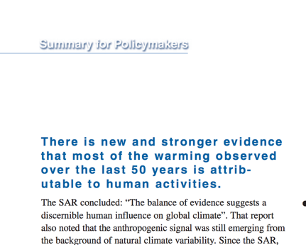
Santer B D et al. IPCC SAR WG1 Ch 8 (1996)
Albritton D L et al. IPCC TAR WG1 (2001)

Slide 30
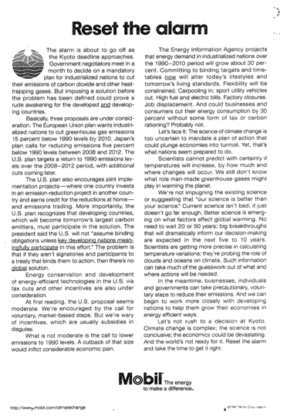
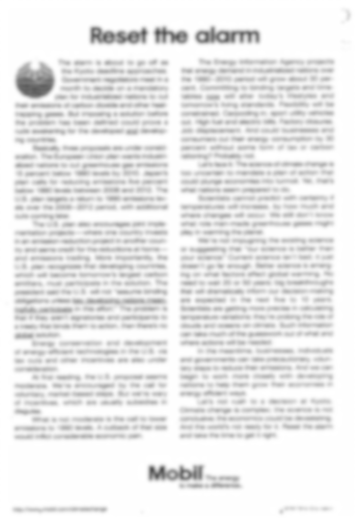
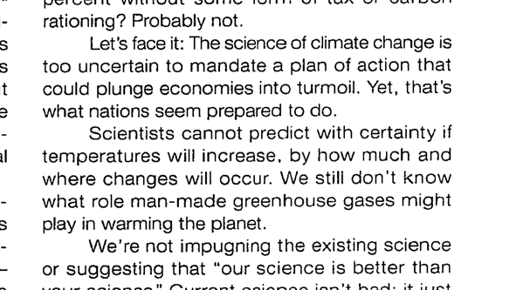
Mobil 1997 Reset the alarm
The New York Times

Slide 31
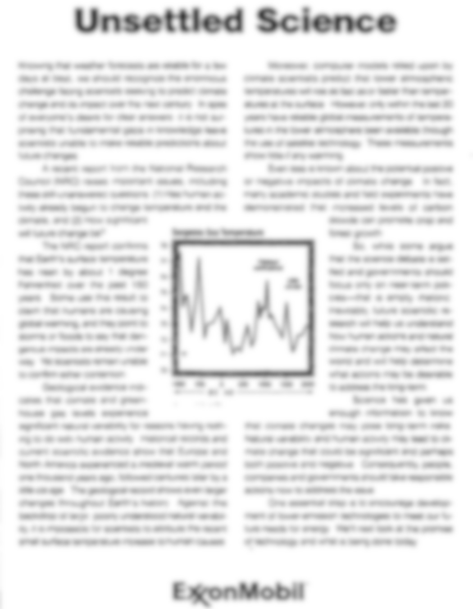
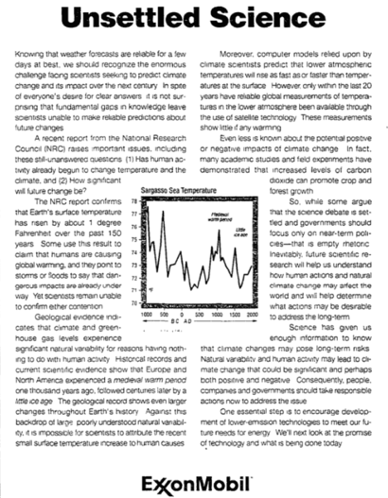
ExxonMobil 2000 Unsettled science.
The New York Times

Slide 32
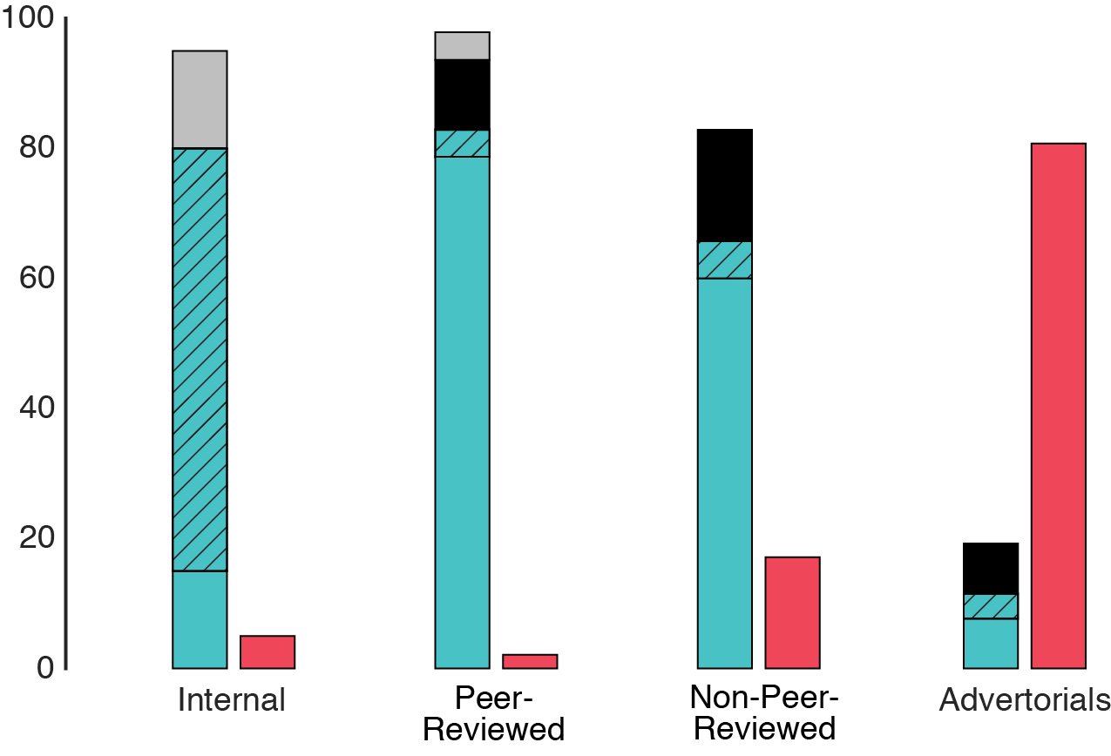
The more public ExxonMobil’s climate communications are,
the more they communicate doubt
% of Documents

Slide 33
The more public ExxonMobil’s climate communications are,
the more they communicate doubt
% of Documents

Slide 34
Have climate communications from
ExxonMobil (Exxon/Mobil/ExxonMobil)
misled customers, shareholders, or the public?
Yes.

Slide 35
Misleading #1: Exxon and ExxonMobil Corp misled with
discrepant communications
(Difference between what they said in public v. what they said In private)
BIG DIFFERENCE!

Slide 36
Science: ~80% Acknowledge
Advertorials: ~80% Doubt

Slide 37
ExxonMobil contributed quietly to the science
yet loudly to raising doubts about it.
Average citations = 21 (peer-reviewed)
2 (non-peer-reviewed)
Intellectually & physically inaccessible

Slide 38
ExxonMobil contributed quietly to the science
yet loudly to raising doubts about it.
<citations> = 21 (peer-reviewed)
2 (non-peer-reviewed)
Intellectually & physically inaccessible
Let “the public to know where we stand”
Readership of millions
“Every Thursday” 1972-2001, $31,000 each
“Advertorials substantially affect levels of
individual issue salience” (Cooper et al. 2004)

Slide 39
Misleading #1: Exxon and ExxonMobil Corp misled with
discrepant communications
(statistical and document-to-document).
Misleading #2: Mobil, Exxon, and ExxonMobil Corp misled with
misinforming advertorials and non-peer-reviewed publications,
which conflicted with mainstream science.

Slide 40
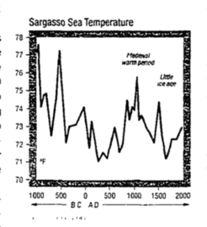
“very misleading”
DR. LLOYD KEIGWIN
Woods hole Oceanographic Institution
Keigwin L D to Altman P. 11 Dec 2000

Slide 41
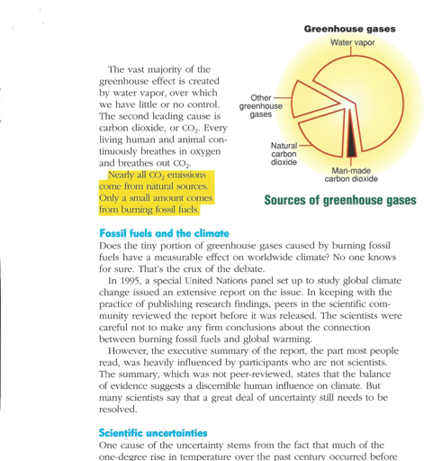
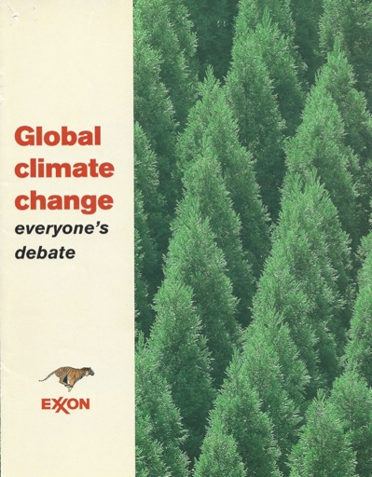
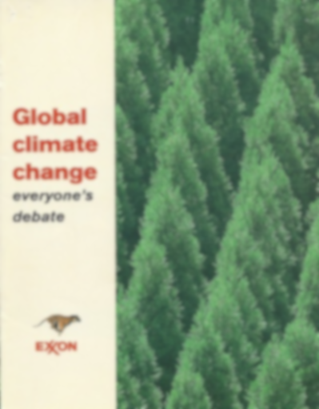
Exxon. Global climate change, everyone’s debate (1998)

Slide 42
Misleading #1: Mobil, Exxon, and ExxonMobil Corp misled with
misinforming advertorials and non-peer-reviewed publications,
which conflicted with mainstream science.
Misleading #2: Exxon and ExxonMobil Corp misled with
discrepant communications
(statistical and document-to-document).
Misleading #3: Exxon and ExxonMobil Corp misled by funding climate denial inconsistent with what the company knew.

Slide 43
“Even though we were writing all these papers [with Exxon scientists]
which were basically supporting the idea that climate change from CO₂ emissions was going to change the climate of the earth according to our best scientific understanding,
the front office...of the company was also supporting people
that we call climate change deniers…they were giving millions of dollars to other entities to support the idea that
the CO₂ greenhouse was a hoax.”
DR. MARTIN HOFFERT
Professor, New York University
Research collaborator with Exxon scientists in the 1980s
Interviewed 2018
Westervelt A (15 Nov 2018) Drilled: A true Crime Podcast about Climate Change, Ep 2

Slide 44
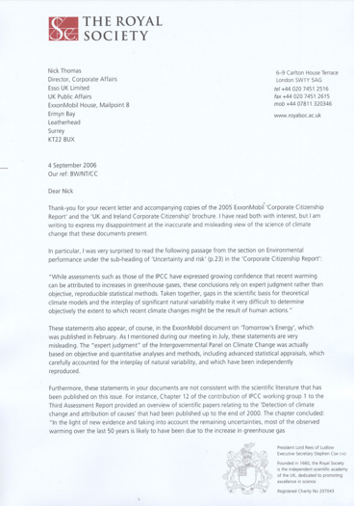
The Royal Society (4 Sept 2006) Letter from Ward B to Thomas N

Slide 45
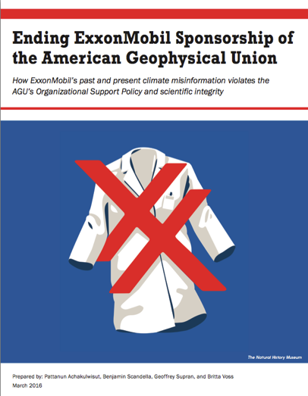
Exxon/ExxonMobil’s
past & present climate denial:
The Company
Contrarian scientists
Third-party organizations
Climate-denying politicians
Online at bit.ly/ExxonReport

Slide 46
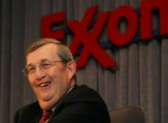
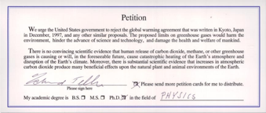
This is a petition signed by 17,000 scientists…
‘There is no convincing scientific evidence…’
2000 EXXONMOBIL SHAREHOLDER MEETING
We in ExxonMobil do not believe that
the science required to establish this linkage
between fossil fuels and warming has been demonstrated - and many scientists agree
2002 ASIA OIL & GAS CONFERENCE
Our ability to project with any degree of certainty the future
Is continuing to be very limited…our examination about the models are [sic] that they’re not competent.
EM
2013 EXXONMOBIL SHAREHOLDER MEETING
Adapted from original graphic.
Paul Horn/ICN not responsible for any changes.
PAUL HORN /InsideClimate News

Slide 47
Exxon/ExxonMobil’s
past & present climate denial:
The Company
Contrarian scientists
Third-party organizations
Climate-denying politicians
Online at bit.ly/ExxonReport

Slide 48
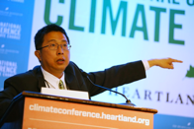
Willie Soon’s “deliverables”
$1.25 million from fossil fuel companies
Funding frequently undisclosed in papers
$335,000 from ExxonMobil Foundation (2005-10)
2003
The 20th century is likely not the warmest nor a uniquely extreme climatic period of the last millennium.
2005
…the hypothesis of a CO2-dominated warming
of the Arctic is not likely consistent…
2009
It’s the Sun, stupid!
2010
…flawed notion…that increasing atmospheric carbon dioxide (CO₂) concentrations will change climate dramatically…
2008
Too much ice is really bad for polar bears
CONTRARIAN
SCIENTISTS
EM
Soon W, Legates D R 2010 Ecol. Law. Curr. 37
Soon W 2007 Phys. Geog. 28, 97
Green K C, Armstrong J S, Soon W 2009 Int. J. of Forecasting 25, 826
Song L InsideClimate News (23 Feb 2015)
Bagley K InsideClimate News (11 Mar 2015)
Greenpeace. Dr. Willie Soon (Feb 2015, bit.ly/PCHR1)
Soon W, et al. 2003 Energy & Environment 14, 233
Soon W W-H 2005 Geophys. Res. Lett. 32 L16712
Soon W 2009 It’s the Sun, stupid!
Adapted from original graphic.
Paul Horn/ICN not responsible for any changes.
PAUL HORN /InsideClimate News

Slide 49
Exxon/ExxonMobil’s
past & present climate denial:
The Company
Contrarian scientists
Third-party organizations
Climate-denying politicians
Online at bit.ly/ExxonReport

Slide 50
$38.7 million+ to 73 climate-denying
organizations (1992-2017)*
*Does not include ~$1 billion to PR and Advertising firms
from fossil fuel industry over the last decade alone.
ExxonSecrets.org
Climate Investigations Center (2019) Trade Associations and the Public Relations Industry
Acton Institute | $365,000
Advancement of Sound Science Center, Inc. | $50,000
AEI American Enterprise Institute | $5,014,000
Africa Fighting Malaria | $30,000
ALEC American Legislative Exchange Council | $1,987,900
American Conservative Union Foundation | $90,000
American Council for Capital Formation - Center for Policy Research | $1,824,523
American Council on Science and Health | $165,000
American Friends of the Institute of Economic Affairs | $50,000
American Spectator Foundation | $115,000
Annapolis Center | $1,198,500
Arizona State University | $49,500
Atlas Economic Research Foundation | $1,082,500
Capital Research Center (Greenwatch) | $265,000
Cato Institute | $155,000
CEI Competitive Enterprise Institute | $2,145,000
Center for a New Europe-USA | $170,000
Center for American and International Law | $514,650
Center for Defense of Free Enterprise | $230,000
Center for the Study of CO2 and Global Change | $100,000
CFACT Committee for a Constructive Tomorrow | $587,000
Chemical Education Foundation | $155,000
Citizens for a Sound Economy (FreedomWorks) | $425,250
Communications Institute | $515,000
Congress of Racial Equality | $325,000
Consumer Alert | $110,000
Environmental Literacy Council | $100,000
Federal Focus | $125,000
Federalist Society | $260,000
Fraser Institute, Canada | $120,000
Free Enterprise Action Institute | $50,000
Free Enterprise Education Institute | $80,000
FREE Foundation for Research on Economics and the Environment | $460,000
Frontiers of Freedom | $1,272,000
George C. Marshall Institute | $865,000
George Mason Univ. Law and Economics Center | $475,000
Heartland Institute | $686,500
Heritage Foundation | $1,030,000
Hoover Institution | $630,000
Independence Institute | $85,000
Independence Institute | $85,000
Independent Women's Forum | $75,000
Institute for Energy Research | $337,000
Institute for Policy Innovaton | $15,000
Institute for Senior Studies | $30,000
Institute for Study of Earth and Man | $93,500
International Policy Network - North America | $390,000
International Republican Institute | $115,000
Landmark Legal Foundation | $166,000
Lexington Institute | $10,000
Lindenwood University, St. Charles, Missouri | $40,000
Manhattan Institute | $1,375,200
Media Institute | $224,720
Media Research Center (Cybercast News Service formerly Conservative News) | $362,500
Mercatus Center, George Mason University | $415,000
Mountain States Legal Foundation | $105,000
National Association of Neighborhoods | $225,000
National Black Chamber of Commerce | $1,165,000
National Center for Policy Analysis | $681,711
National Center for Public Policy Research | $445,000
National Legal Center for the Public Interest | $216,500
National Taxpayers Union Foundation | $865,000
Pacific Legal Foundation | $360,000
Pacific Research Institute for Public Policy | $680,000
PERC Property and Environment Research Center (formerly Political Economy Research Center) | $177,500
Reason Foundation / Reason Public Policy Institute | $493,500
Regulatory Checkbook | $50,000
Science and Environmental Policy Project | $35,000
Smithsonian Astrophysical Observatory | $417,212
Tech Central Science Foundation | $95,000
Texas Public Policy Foundation | $80,000
US Chamber of Commerce Foundation | $4,015,000
Washington Legal Foundation | $555,000
Weidenbaum Center | $412,500
TOTAL FUNDING OF CLIMATE-DENYING ORGANIZATIONS | $38,680,166
THINK TANKS
CONTRARIAN
SCIENTISTS
EM
Adapted from original graphic.
Paul Horn/ICN not responsible for any changes.
PAUL HORN /InsideClimate News

Slide 51
$38.7 million+ to 73 climate-denying
organizations (1992-2017)
“Role of greenhouse gases in climate change is
not well understood”
$13M in 1997 anti-Kyoto ad campaign
$63M in political contributions (1989-99)
1996: ‘The IPCC: Institutionalized Scientific Cleansing?’
THINK TANKS
CONTRARIAN
SCIENTISTS
EM
Supran G et al. Fossil Free MIT (2015, bit.ly/PCHR2)
Achakulwisut P et al. Ending ExxonMobil Sponsorship of the American Geophysical Union (2016), bit.ly/ExxonReport)
Frumhoff P, Heede R, Oreskes N. Climatic Change 132, 157 (2015)
ExxonSecrets.org
Adapted from original graphic.
Paul Horn/ICN not responsible for any changes.
PAUL HORN /InsideClimate News

Slide 52
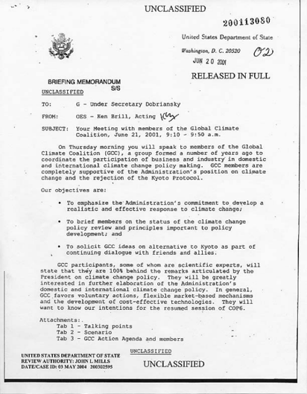
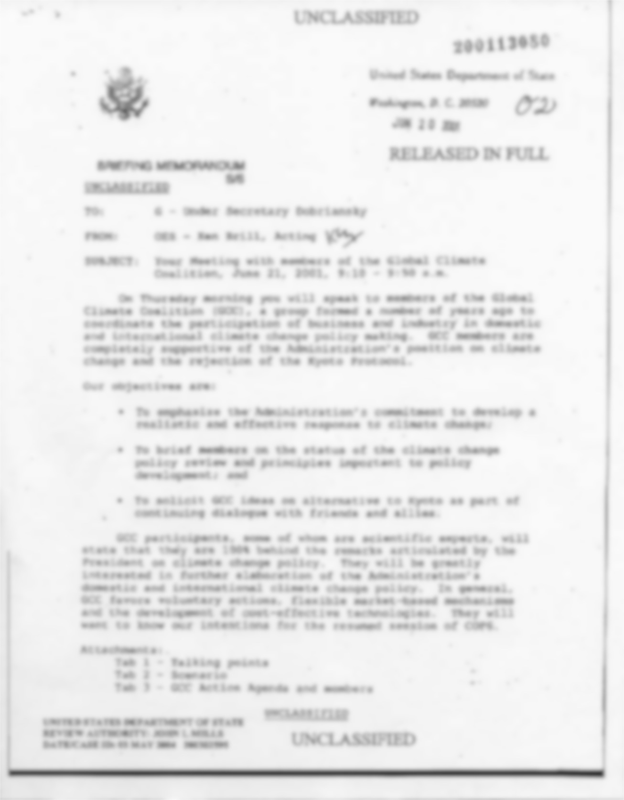
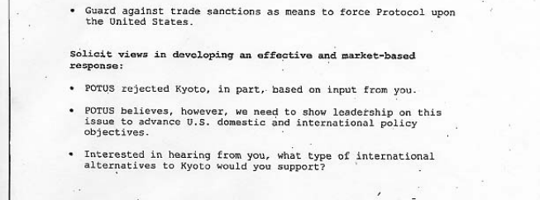
Brill K (2001) Letter to Dobriansky P

Slide 53
Exxon/ExxonMobil’s
past & present climate denial:
The Company
Contrarian scientists
Third-party organizations
Climate-denying politicians
Online at bit.ly/ExxonReport

Slide 54
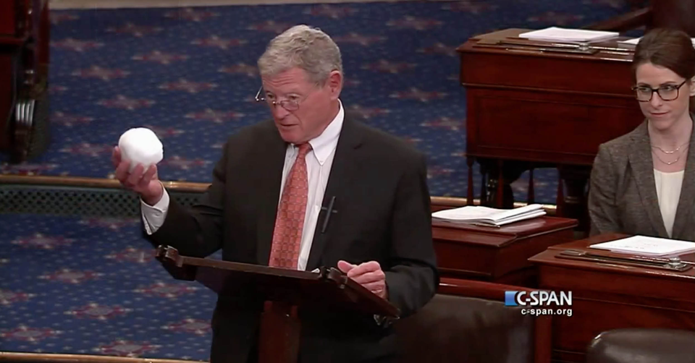
“The idea that manmade gases, CO₂, are causing
catastrophic global warming is the greatest hoax
ever perpetrated on the American people”
SENATOR JAMES INHOFE

Slide 55
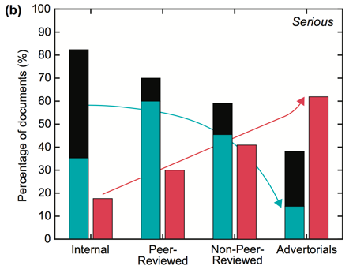
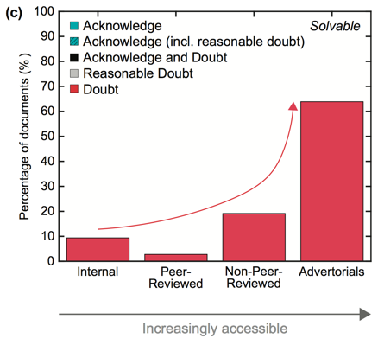
ExxonMobil also misled about climate change as serious & solvable
Serious
Solvable

Slide 56
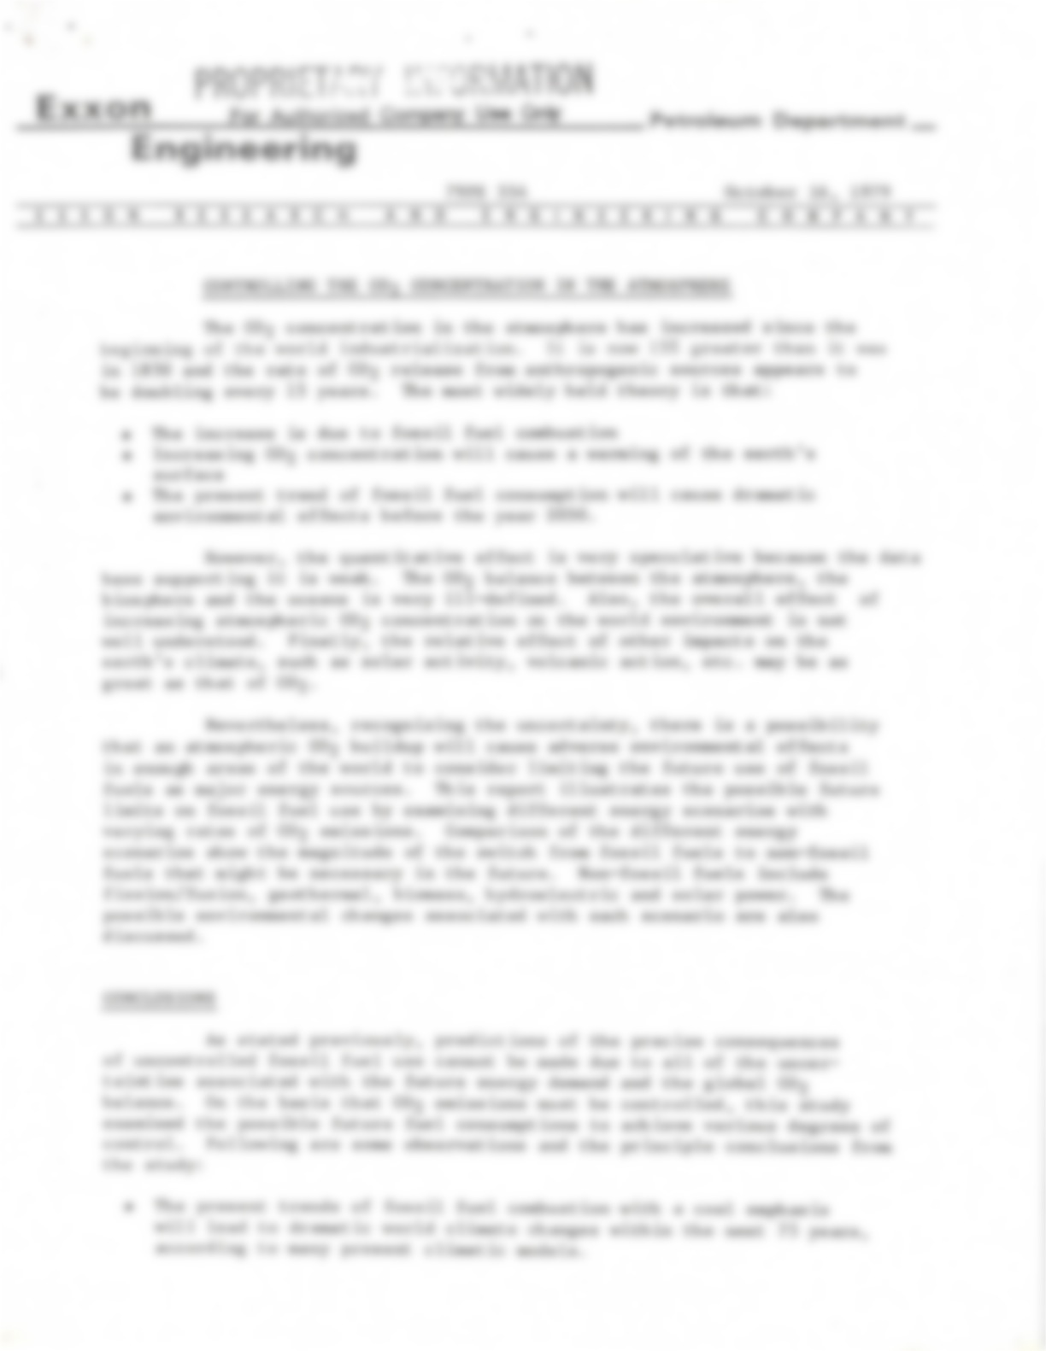
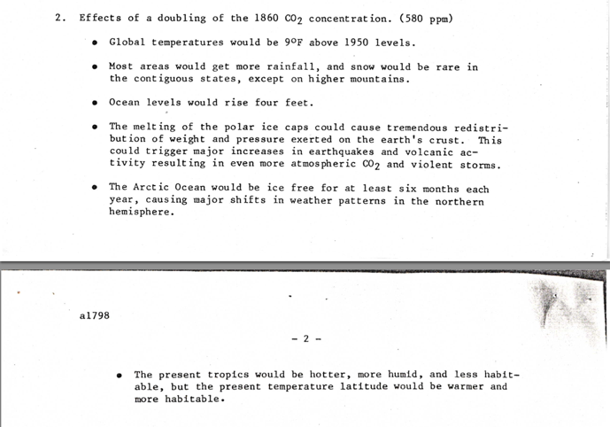
Mastracchio R L 1979
Controlling Atmospheric CO₂

Slide 57
ExxonMobil. Do No Harm
The New York Times (2000)

Slide 58
Misleading on stranded fossil fuel assets: 24 documents allude to stranded assets, but no advertorials do so
Glaser M B 1982 CO₂ ‘Greenhouse’ Effect

Slide 59
Misleading on stranded assets: 24 documents allude to stranded fossil fuel assets, but no advertorials do so
2015–2100 CO₂ budgets:
(<2°C and/or [CO₂] < 550 ppm)
ExxonMobil: 251–716 GtC
IPCC: 442–651 GtC
Glaser M B 1982 CO₂ ‘Greenhouse’ Effect
Kheshgi H S, Jain A K Glob Biogeochem Cycl 17, 1047 (2003)

Slide 60
Have climate communications from
ExxonMobil (Exxon/Mobil/ExxonMobil)
misled customers, shareholders, or the public?
Yes.

Slide 61
(1) Climate science research
“Highly visible programs” (1978)
“Establish a scientific presence”
“Maintain awareness of new scientific developments” (1984)
“Credentials required to speak with authority in this area” (1980)
“Detailed understanding of the total Federal atmospheric CO₂ program
which the Corporation needs for its own planning” (1981)
?
(2) Public relations campaign
“Great public relations value” (1978)
‘CO₂ Greenhouse Communications Plan’ to target “opinion leaders who are not scientists” (1980)
Shaw H Untitled (request for a credible scientific team) (1978)
Werthamer N R CO2 Greenhouse Communications Plan (1980)
Carlson J M The Greenhouse Effect (1988)
Werthamer N R CO2 Greenhouse Communications Plan (1980)
Levine D G Potential Enhanced Greenhouse Effects Status and Outlook (1989)
Long G H Atmospheric CO2 Scoping Study (1981)
Cohen R W, Levine D G Untitled (consensus on CO2 letter) (1982)
Adapted from original graphic.
Paul Horn/ICN not responsible for any changes.
PAUL HORN /InsideClimate News

Slide 62
1980s: Exxon develops “CO₂ Greenhouse Communications Plan” to
“emphasize the uncertainty”
Levine D G 1989 Potential Enhanced Greenhouse Effects Status and Outlook Carlson J M 1988 The Greenhouse Effect

Slide 63
1990s: Oil industry develops “uncertainty” strategy
Global Climate Science Communications Team (1998) Global Climate Science Communications Plan

Slide 64
1990s: Coal industry Strategy Document:
Position global warming as theory not fact & enroll electricity industry as ally
Informed Citizens For the Environment (1991) Mission Statement, Oreskes, Naomi, 2010. “My facts are better than your facts: Spreading good news about global warming.” in How Well Do Facts Travel? Edited by Mary S. Morgan and Peter Howlett, Cambridge University Press, pp. 135-166.

Slide 65
Big Oil is the new Big Tobacco
 |  | TOBACCO | FOSSIL FUELS
STRATEGY | Develop detailed understanding of products’ dangers | ✓ | ✓
 | Denial of consensus – including internal – science | ✓ | ✓
 | Subvert evidence in policymaking | ✓ | ✓
 | Reshape media | ✓ | ✓
 | Preempt litigation & regulation | ✓ | ✓
TACTICS & INFRASTRUCTURE | Internal research to inform decision-making and PR | ✓ | ✓
 | Direct denial | ✓ | ✓
 | Shift to indirect denial & lobbying (‘think tanks’, AstroTurf groups, PR firms, lobby groups, trade associations, politicians) | ✓ | ✓
 | Contrarian scientists and talking heads | ✓ | ✓
 | Colonization of academia | ✓ | ✓
 | Aggressive, predatory marketing at unprecedented scale | ✓ | ✓
RHETORIC | Doubt mongering | ✓ | ✓
 | Shift from explicit doubt to “risk” rhetoric | ✓ | ✓
 | Appeal to techno-fixes & solutions misinformation | ✓ | ✓
 | Consumer risk and choice versus industry responsibility | ✓ | ✓
 | Appeal to libertarian and free-market conservative ideologies | ✓ | ✓
 | Never acknowledge deception | ✓ | ✓

Slide 66
Climate denial machine
Fossil Fuel
Industry
Corporate
Interests
Conservative
Foundations
Think Tank Networks
PR/Ad Firms
The Carbon-Combustion Complex
Think Tanks
Front Groups
Politicians
Media
Blogs
Contrarian Scientists & AstroTurf Campaigns
Adapted from Dunlap R E & McCright A M (2011)
The Oxford Handbook of Climate Change and Society, Ch 10

Slide 67
4,556 individuals
164 organizations
Farrell, J. Nat Clim Chg. 6, 370 (2015)
Farrell, J. PNAS. 113, 92 (2015)

Slide 68
“ecosystem of influence”
Funded by
ExxonMobil
Not funded by
ExxonMobil
Farrell, J. Nat Clim Chg. 6, 370 (2015)
Farrell, J. PNAS. 113, 92 (2015)

Slide 69
MOD Tillerson and Putin deal to drill in Arctic

Slide 70
Culminates in Appointment of ExxonMobil CEO Rex Tillerson as Secretary of State

Slide 71
KOCH BROTHERS
API
“It is reasonable to conclude that climate change denial campaigns in the US have played a crucial role in blocking domestic legislation and contributing to the US becoming an impediment to international policy making.”
POLITICIANS
THINK TANKS
CONTRARIAN
SCIENTISTS
EM
Dunlap R E & McCright A M (2011)
The Oxford Handbook of Climate Change and Society, Ch 10
Adapted from original graphic.
Paul Horn/ICN not responsible for any changes.
PAUL HORN /InsideClimate News

Slide 72
Overall, this is a bad news story:
ExxonMobil and their allies have known the truth about climate science and its implications for more than half a century!
But instead of being part of the solution, they chose to mislead the public and policymakers and work to block sensible action to protect the American people.

Slide 73
Fossil fuel companies and trade associations, including ExxonMobil, have promoted disinformation about climate change so as to stifle action by misleading the public and policymakers.
Sadly, until now they have succeeded.

Slide 74
But while time is running out, it has not yet run out.

Slide 75
Good news: There is still time to change the ending of this story from this….

Slide 76
Or worse, this…….

Slide 77
To this!

Slide 78
Additional slides

Slide 79
Profit
&
Ideology
Distrust in science, media, government
Anti-science &
anti-policy
climate denial
Brown M B (2014) Culture, Politics and Climate Change: How Information Shapes our Common Future, Ch 6
Dunlap R E & McCright A M (2011) The Oxford Handbook of Climate Change and Society, Ch 10
Farand C, Hope M (18 Nov 2018) DeSmogUK

Slide 80
769,000-3.5 million
They are in every state
More in ‘red’ states than in ‘blue’ ones.
One of the fastest growing sectors of US Economy. 13% growth in 2015 (Bureau of Labor statistics)
Even at the low end, that’s
3x the jobs in fossil fuels.
http://www.eesi.org/papers/view/fact-sheet-jobs-in-renewable-energy-and-energy-efficiency-2015

Slide 81
Additional slides on Europe

Slide 82
“Arguments emphasising scientific uncertainty have achieved political traction in the United Kingdom, creating a ‘fog of distrust’ instrumental in
draining political capital from the
active implementation of climate policy.”
Sharman A & Perkins R (2017) Environment and Planning A 49 2281

Slide 83
Europe’s Web of Denial
Corporate Europe Observatory (Dec 2010)
Concealing their sources – who funds Europe’s climate change deniers?

Slide 84
Climate denial machine
ExxonMobil
API
Koch Foundation
Institute for
Energy Research
Politicians
Media
Blogs
Study Author
Alvarez G C (2010) Procesos De Mercado VII, 1
bit.ly/2UA01Ma; bit.ly/2HvFGoD; bit.ly/2HmIeoI

Slide 85
Climate denial machine
ExxonMobil
International
Policy Network
Center for
New Europe
Politicians
Media
Blogs
Study Author
bit.ly/2O76agz

Slide 86
Climate denial machine
ExxonMobil
Koch Foundation
Atlas Network
Instituto
Juan de Mariana
Politicians
Media
Blogs
Study Author
bit.ly/2Hqmubw
Harkinson J (22 Dec 2009) Mother jones

