Slide 1
Celebrating our Centennial, Promoting our Conservation Community
Earl Hower, Director of Chapter Relations
Michael Reinemer, Director of Communications
Janette Rosenbaum, Strategic Communications Manager
Notes:
[Introduce topic and speakers] Welcome to today’s “Celebrating our Centennial, Promoting our Conservation Community” webinar.
My name is Earl Hower, the Director of Chapter Relations for the League.
We are fortunate to be joined today by two other of my fellow staff members from the National Office:
Michael Reinemer, our Director of Communications and Editor of Outdoor America … With his decades of experience in communications, marketing and media relations.
And Janette Rosenbaum, is the League’s Strategic Communications Manager … With her specialty in e-communications, she brings to the table her expertise in website and social media development.
>> Before we get started, I’d like to have Janette explain how to submit questions and comments. And we’ll do our best to answer them at the conclusion.

Slide 2
Today’s Webinar Topics
Increasing your local recognition during the Izaak Walton League’s centennial with available resources
Raising awareness through press outreach
Increasing your visibility, with the power of the internet
Notes:
Here’s a quick preview the three topics we’ll be covering today …
I’ll be covering the first “Increasing your chapter’s local recognition during the Izaak Walton League’s centennial with available resources and support from the National Office.”
Michael’s portion covers media relations and “Raising awareness through press outreach.”
Of course, its only logical that Jannette’s presentation will be: “Increasing your visibility, with the power of the internet.”

Slide 3
Increasing your local recognition during the Izaak Walton League’s centennial with available resources
Notes:
[NEXT]

Slide 4
IWLA Centennial Challenge 100th Anniversary Chapter Outreach and Involvement Project
Partner in the promotion, participation and celebration of the Izaak Walton League’s 100th Anniversary in 2022.
Improve the League’s brand and chapter’s name recognition and local standing in the community.
Generate financial support with contributions to the
League and the chapter.
Notes:
I am going to give you an advanced, sneak peek at the IWLA Centennial Challenge to be launched later this year.
The goals of this project are to challenge chapters to:
Partner in the promotion, participation and celebration of the Izaak Walton League’s 100th Anniversary in 2022.
Improve the League’s brand and chapter’s name recognition and local standing in the community. And THIS is the focus of today’s webinar.
Generate financial support with contributions to the League and the chapter.
[NEXT]

Slide 5
IWLA Centennial Challenge 100th Anniversary Chapter Outreach and Involvement Project
Chapter Promotional Efforts
Local Press Outreach - “Promoting Chapter with Local Media”
“Centennial Community Conservation Projects”
Outdoor Recreational Events - “Celebrate Outdoor America”
Chapter Centennial Celebration Fund-Raising
Notes:
… And a brief outline of this Project components include:
Chapter Promotional Efforts
Local Press Outreach - “Promoting Chapter with Local Media”
“Centennial Community Conservation Projects”
Outdoor Recreational Events - “Celebrate Outdoor America”
Chapter Centennial Celebration Fund-Raising

Slide 6
Centennial Resources
Yard Signs and Banners
Centennial Community Conservation Project Signs
Chapter Fund-Raising Packages
Historical Book and Video
IWLA 100th Anniversary Merchandise
Notes:
Here are some of the planned resources and support that will be made available in the fall of 2021 and for your chapter’s use throughout 2022:
Yard Signs and Banners with 100th logo -- for all chapters to proudly display.
Centennial Community Conservation Project Signs -- to call out such local chapter-sponsored projects.
Chapter Fund-Raising Packages -- to help chapter raise funds during their own centennial celebration event.
100th Anniversary Historical Book and Video -- both have obvious appeals. Plus, the video can be shown during such celebrations and linked to chapter websites.
And available in the near future, are items such as apparel [shirts, tees and caps], glassware and water bottles, tote bags, and much more.
Again, you’ll be hearing more about this exciting challenge in months to come, including during the upcoming virtual National Convention in July, issue of Outdoor America and chapter president communications.

Slide 7
Centennial Support
100th Anniversary Logo
Promotional Chapter Posters and Customized Chapter Brochures
IWLA Webpage www.iwla.org/100years
“IWLA 100 Year History Fact Sheet”
Notes:
Also available, will be such support to help chapter celebrate and market the chapter in 2022 include:
The first is obvious. We designed a 100th Anniversary logo -- shown here -- that is currently available to chapters for their use on their printed materials, website and perhaps locally generated sales items.
Our free Chapter Promotional Posters and Customized Chapter Brochures all have the 100th logo prominently displayed and ready for chapters to use, promote events and recruit members.
National website with a dedicated 100th anniversary webpage as a quick link when reaching out to local media.
And likewise, a soon-to-be-prepared IWLA 100 Year History Fact Sheet for use when raising awareness through press outreach efforts.

Slide 8
IWLA Centennial Challenge 100th Anniversary Chapter Outreach and Involvement Project
Chapter Promotional Efforts
Local Press Outreach - “Promoting Chapter with Local Media”
“Centennial Community Conservation Project”
Outdoor Recreational Event - “Celebrate Outdoor America”
Chapter Centennial Celebration Fund-Raising
Notes:
… Local press [or media] outreach and how to promote your Chapter with local media during the League 100th anniversary.
Again, we are here to help you -- not only to improve the League’s brand -- but also the chapter’s name recognition and local standing in the community.
Now to Michael.

Slide 9
IWLA Centennial Challenge 100th Anniversary Chapter Outreach and Involvement Project
Chapter Promotional Efforts
Local Press Outreach - “Promoting Chapter with Local Media”
“Centennial Community Conservation Project”
Outdoor Recreational Event - “Celebrate Outdoor America”
Chapter Centennial Celebration Fund-Raising
Notes:
… Local press [or media] outreach and how to promote your Chapter with local media during the League 100th anniversary.
Again, we are here to help you -- not only to improve the League’s brand -- but also the chapter’s name recognition and local standing in the community.
Now to Michael.

Slide 10
Raising awareness through press outreach

Slide 11
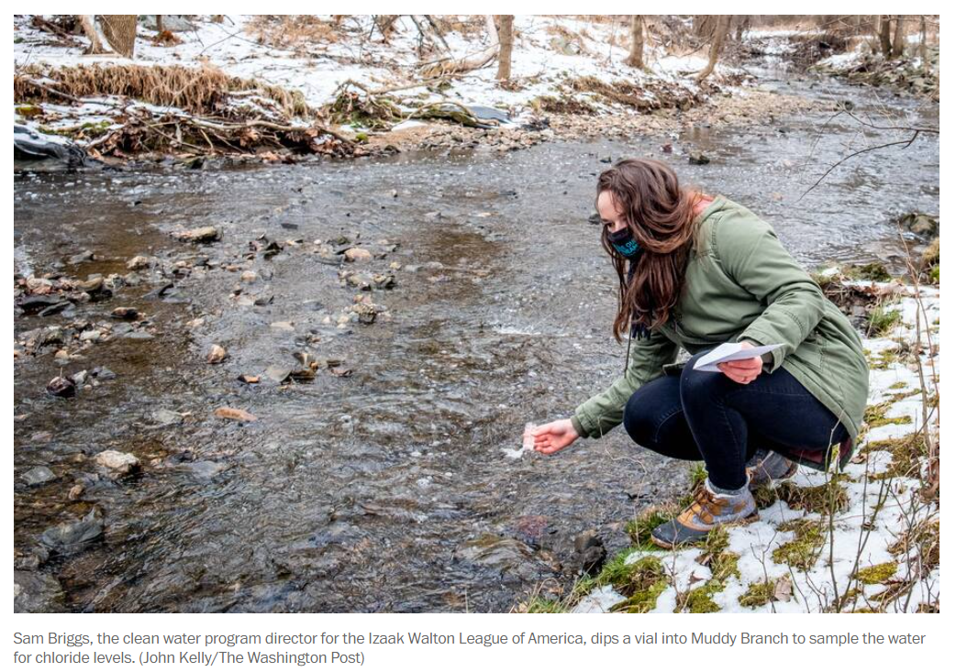
Raising awareness through press outreach
Work with journalists to get coverage in newspapers, TV, radio.
The result is called “earned media.” We have to earn it.

Slide 12
Build a relationship with your local press
NOW is a great time to communicate with reporters.
Review Unit VI: Communications and Marketing of your IWLA Chapter Manual.
Prepare a 1-page chapter history to share with press.
Meanwhile, share occasional notes about activities with your local press.

Slide 13
Opportunity to discuss on past, present, future.
100th anniversary reminds us that the concerns and passions of our founders in 1922 are still valid today.
Past: Your chapter is part of the community’s history.
Present: Your chapter continues to provide benefits.
Future: Future generations will also need the League.

Slide 14
Specific story ideas
Interesting programs or events from your or the League’s past (Don’t Be a Litter-Bug, Save Our Streams)
How you help to conserve natural resources and promote enjoyment of outdoor traditions.
Mention current activities: stream clean-ups, conservation education, gun safety, engaging youth, etc.

Slide 15
Tactics for pitching local reporters
Individual, personalized emails with useful information to specific reporters is a best practice.
Letters to the editor or guest editorials (op-eds) are ways to get your specific messages into newspapers.
Again, the topic could be the anniversary, specific chapter programs that help the community, youth activities…

Slide 16
National Office can help with earned media
We can provide contact information for some of your local reporters or news outlets.
We can review materials and tactics and discuss any questions you may have.
Michael’s email: mreinemer@iwla.org.

Slide 17
Increasing your visibility, with the power of the internet

Slide 18
What is “raising awareness”?

Slide 19
Whose awareness do you want to raise?

Slide 20
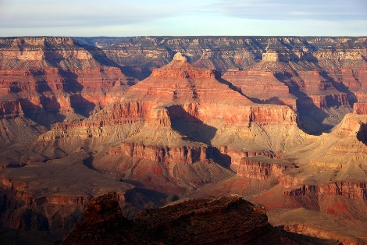
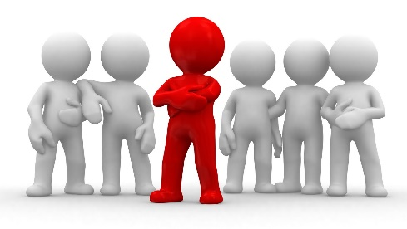
Watch out!
“Ike?”

Slide 21
Raising awareness on social media
Show service
Advertise events
Put people in focus
Highlight amenities
Celebrate accomplishments
Reveal history
Follow your fellow Ikes

Slide 22
Raising awareness on social media
Two posts a week is enough
Always include an image
Pixabay
Pexels
Unsplash
Always Like your own posts

Slide 23
Raising awareness on social media
29% are not
following you yet!
96% don’t see
your post!

Slide 24
Raising awareness with a website
Chapters That Have Built Google Websites
Bill Cook (WI)
Chicago #1 (IL)
Davenport (IA)
Fremont (OH)
Grand Island (NE)
Miami County (IN)
Miller (IN)
Peoria (IL)
Prince William (VA)
Southwestern Wisconsin (WI)
W.J. McCabe (MN)
Yankton Area (SD)
95% start by
searching the internet

Slide 25
Raising awareness with a website
Archives of event photos, member testimonials, achievements
Virtual tour of amenities
Event information

Slide 26
We only turn 100 once!
Notes:
Finally…
It’s our 100th anniversary.
So, use the logo. It’s easy. We all love the traditional bust, but the anniversary logo communicates much more about who we are.
Spend the next 18 months working hard to promote your chapter in your community. If not now, when?
You are the ones lucky enough to celebrate this amazing milestone with the Izaak Walton League of America.
You are the ones responsible for carrying the League’s legacy into a second century. Past Ikes are counting on you … and so is the future of conservation.

Slide 27
Questions Now ?
Notes:
[We’ll take live questions here]

Slide 28
Questions Later ?
Increasing your local recognition during the Izaak Walton League’s centennial with available resources
Earl Hower, ehower@iwla.org
Director of Chapter Relations
Raising awareness through press outreach
Michael Reinemer, mreinemer@iwla.org
Director of Communications
Increasing your visibility, with the power of the internet
Janette Rosenbaum, jrosenbaum@iwla.org
Strategic Communications Manager
Webinar was recorded and will be posted online at: www.iwla.org
Notes:
[Summarize]
The bottomline: Start now to prepare for our 100th anniversary and work with local media and promote your Chapter locally during 2022 and beyond.
Again, the national staff are available to help you -- not only to improve the League’s brand -- but also the chapter’s name recognition and local standing in the community.
You may contact any or all of us with questions that arise later.
This webinar was recorded and will be posted online, should you wish to review and share with others at your chapter.

Slide 29
Celebrating our Centennial, Promoting our Conservation Community Thank You!
Notes:
Thank you again for joining us today!
[End of webinar]

